Slide 1

Music Player
Alok Gupta : 21104028
Sankalp Gunjal : 21104087
Yatish Gharat : 21104050
Project Guide : Prof. Shital Agrawal

Slide 2
Contents
Introduction
Objectives
Scope
Features / Functionality
Project Outcomes
Technology Stack

Slide 3
1. Introduction
Most software companies develop so many types of players that they can support MP3 files . We need an application that will allow us to play or listen to digital audio files . This program allows you to play all types of “.mp3” music files present on your desktop or laptop.
The Media Player also consists of the interface to list the music files available. Python has libraries that can play audio files, such as: Pygame, which allows you to work with media files in just a few lines of code.
Problem Definition :
Compatibility of music player to play audio files with different type of operating systems .

Slide 4
2. Objectives :
Create a user-friendly GUI.
This system can be used to play audio files .
The interface is kept simple which makes it appealing and convenient to use.
To create buttons which can enact particular tasks and select files from the directory.

Slide 5
3. Scope
A music player in Python can be implemented in a number of ways, depending on the scope and requirements. Here is a basic outline of the steps you would need to follow to create a basic music player in Python:
Music Library : The ability to organize music files in the library.
Music Playback: The ability to play music files, including support only for common music file formats such as MP3 .

Slide 6
4. Feature /Functionality
Music Player Features:-
  A GUI that allows the user to interact with the music player.
  It consists of various buttons as functions such as play, pause, previous, next, add library, add songs, remove song, volume control, displaying upcoming and playing now songs.
  The music player consists of basic features like displaying the music files of a particular folder and playing the selected songs.

Slide 7
5. Outcome of Project
The User Experience:-
  A well-designed and functional music player can provide a better experience for users, making it easier for them to play and manage their music.

Slide 8
6. Technology Stack
The technology stack used in a music player using Python can include the following components:
Python: As the main programming language, Python provides a rich set of libraries and frameworks for building a music player application.
Pygame : A popular Python library for creating games and multimedia applications, Pygame can be used to build the UI and handle audio playback in a music player.
Tkinter : A standard GUI library for Python that can be used to build the user interface for the music player.

Slide 9
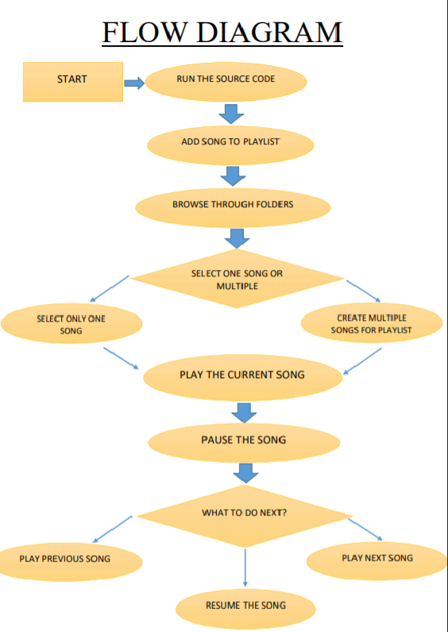
7. Flow Chart

Slide 10
Thank You...!!

